Slide 1
8051 MEMORY ORGANIZATION
divided into
Program Memory and
Data Memory
Program Memory (ROM) is used for permanent saving program being executed
Data Memory (RAM) is used for temporarily storing and keeping intermediate results and variables.

Slide 2
8051 PROGRAM MEMORY (ROM)
Program Memory (ROM) is used for permanent saving program (CODE) being executed.
8051 memory organization allows external program memory to be added.
If EA=0 , the microcontroller completely ignores internal program memory and executes only the program stored in external memory.
If EA=1 In this case, the microcontroller executes first the program from built-in ROM, then the program stored in external memory.

Slide 3
8051 Interrupts
The 8051 microcontroller has FIVE interrupts in addition to Reset. They are
Timer 0 overflow Interrupt
Timer 1 overflow Interrupt
External Interrupt 0
External Interrupt 1
Serial Port events (buffer full, buffer empty, etc) Interrupt

Slide 4
8051 Interrupts
Each interrupt has a specific place in code memory where program execution (interrupt service routine) begins.
External Interrupt 0: 0003 H
Timer 0 overflow: 000B H
External Interrupt 1: 0013 H
Timer 1 overflow: 001B H
Serial Interrupt : 0023 H
(Interrupt lists above in the decreasing order)

Slide 5
Special Function Registers
There are 21 SFRs.
In addition to I/O ports, the most frequently used SFRs to control and configure 8051 operations are:
TCON (Timer CONtrol)
TMOD (Timer MODe)
TH0/TH1 and TL0/TL1 (Timer’s high and low bytes)
SCON (Serial port CONtrol)
IP (Interrupt Priority)
IE ( Interrupt Enable)

Slide 6

Timer Mode Register(TMOD)
GATE: This bit is used to start or stop the timers by hardware .When GATE= 1 ,the timers can be started / stopped by the external sources. When GATE= 0, the timers can be started or stopped by software instructions like SETB TR0 or SETB TR1
C/T (clock/Timer) : C/T = 0 ,the Timer is used as delay generator and if C/T=1 the timer is used as an event counter.

Slide 7
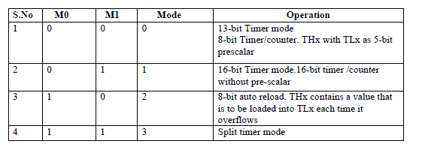
Timer Mode Register(TMOD)

Slide 8

Timer Control Register(TCON)
TF0/TF1: Timer0/1 overflow flag is set when the timer/
counter overflows, reset by program
TR0/TR1: Timer0/1 run control bit is set to start, reset to
stop the timer0/1
IE0/IE1: External Interrupt 0/1 edge detected flag: 1 is set
when a falling edge interrupt on the external port 0/1.
IT0/IT1 External Interrupt Type (1: falling edge triggered, 0
low level triggered)

Slide 9
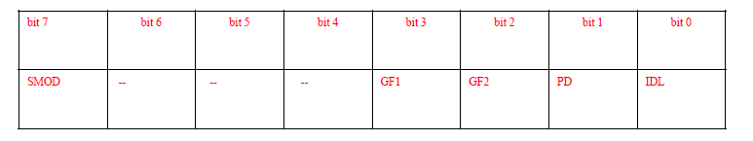
PCON ( Power Control Register)
SMOD(serial mode) 1= high baud rate, 0 = low baud rate
• GF1, GF2 flags for free use
• PD: 1= power down mode for CMOS
• IDL: 1= idle mode.
In Power Down mode, the oscillator clock provided to system is OFF i.e. CPU and peripherals clock remains inactive in this mode.
In Idle Mode, only the clock provided to CPU gets deactivated ,whereas peripherals clock will remain active in this mode.
Hence power saved in power down mode is more than in idle mode.

Slide 10
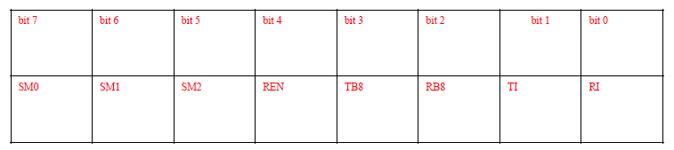
SCON ( Serial Port Control Register)
REN: Receiver enable is set/reset by program
TB8: stores transmitted bit 8(9th bit, the stop bit)
RB8: Stores received bit 8(9th bit, the stop bit)
TI: Transmit Interrupt is set at the end of 8th bit (mode 0)
or at the stop bit (other modes) indicating the completion
of one byte transmission, reset by program
• RI: Receive Interrupt is set at the end of 8th bit (mode 0)
or at the stop bit (other modes) indicating the completion
of one byte receiving, reset by program
RI and TI flag in SCON SFR are used to detect the interrupt events.
If RI = 1 then a byte is received at the RxD pin. If TI = 1 then a byte is
transmitted from the TxD pin.

Slide 11
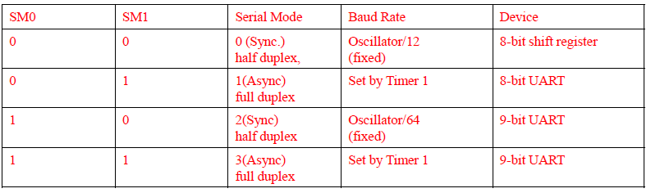
SCON ( Serial Port Control Register)

Slide 12

Interrupt Enable Register (IE)
EA : Global enable/disable. To enable the interrupts this bit must be set High.
Undefined-reserved for future use.
ET2 : Enable /disable Timer 2 overflow interrupt.
ES : Enable/disable Serial port interrupt.
ET1 : Enable /disable Timer 1 overflow interrupt.
EX1 : Enable/disable External interrupt1.
ET0 : Enable /disable Timer 0 overflow interrupt.
EX0 : Enable/disable

Slide 13

Interrupt Priority Register (IP)
IP.7: reserved
IP.6: reserved
IP.5: Timer 2 interrupt priority bit (8052 only)
IP.4: Serial port interrupt priority bit
IP.3: Timer 1 interrupt priority bit
IP.2: External interrupt 1 priority bit
IP.1: Timer 0 interrupt priority bit
IP.0: External interrupt 0 priority bit

Slide 14
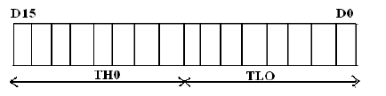
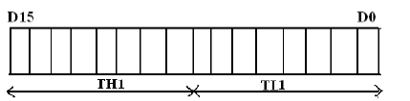
TIMER 0 and TIMER 1

Slide 15
MODULE-6

Slide 16
8051 Addressing Modes
An addressing mode refers to how you are addressing a given memory location. There are five different ways or five addressing modes to execute this instruction which are as follows −
Immediate addressing mode
Direct addressing mode
Register direct addressing mode
Register indirect addressing mode
Indexed addressing mode

Slide 17
Immediate Addressing Mode
data operand is a constant and it is a part of the instruction itself
the data must be preceded by a # sign.
Eg:-MOV A, #6AH
The data (constant) 6A is moved to the accumulator register

Slide 18
Direct addressing mode
data operand is in the RAM location (00 -7FH) and the address of the data operand is given in the instruction
uses the lower 128 bytes of Internal RAM and the SFRs
Eg:-MOV R1, 42H : Move the contents of RAM location 42 into R1 register
MOV 49H,A : Move the contents of the accumulator into the RAM location 49.

Slide 19
Register addressing mode
data operand to be manipulated lies in one of the registers
Eg:-
MOV A,R0 : Move the contents of the register R0 to the accumulator
ADD A,R6 :Add the contents of R6 register to the accumulator
MOV P1, R2 : Move the contents of the R2 register into port 1

Slide 20
Register Indirect addressing mode
the address of the data is stored in the register and the register is given as operand in the instruction.
Eg:-
MOV A,@ R0 :Move the contents of RAM location whose address is in R0 into A (accumulator)
MOV @ R1 , B : Move the contents of B into RAM location whose address is held by R1

Slide 21
Indexed addressing mode
used in accessing the data elements of lookup table entries located in program ROM space of 8051.
Eg:-
MOVC A,@ A+DPTR
The 16-bit register DPTR and register A are used to form the address of the data element stored in on-chip ROM. C denotes code .
In this instruction the contents of A are added to the 16-bit DPTR register to form the 16-bit address of the data operand

Slide 22
Register Specific(Implicit)Addressing Mode
The operand is implicitly specified using one of the registers
Some of the instructions operate only on specific registers.
Eg:- RLA

